Slide 1
Attribute Selector

Slide 2
Agenda
Attribute Selector
Sample output
Attribute Selector implementation

Slide 3
Attribute Selector
Attribute selector is used to select a tag and style based on its value.
We have various cases in Attribute Selector
Case 1:
[attribute]
Example:
a[target] /* select all a tags with target attribute */
Case 2:
Styling with the help of attribute and its value
Example:
[class = “car”]

Slide 4
Attribute Selector
Case 3:
With below attribute syntax we can style the tag whose attribute value includes space separated word only.
[attribute~="value"] {
}
Example:
If <img title= “car”> or <img title= “ green car”>, then the CSS properties are applied to that tag.
[title~="car"] {
}

Slide 5
Attribute Selector
Case 4:
With below attribute syntax we can style the tag whose property value includes space separated or hyphen words
[attribute|="value"] {
}
Example:
If <p class = “car”> or <p class= “car-BMW”>, then the CSS properties are applied to that tag.
[class|="car"] {
}

Slide 6
Attribute Selector
Case 5:
With below attribute syntax we can style the tag whose attribute value includes the beginning characters of the word
[attribute^="value"] {
}
Example:
If <p id= “car color”> or <p id= “ car-color”> or <p id= “carcolor”>, then the CSS properties are applied to that tag.
[id^="car"] {
}

Slide 7
Attribute Selector
Case 6:
With below attribute syntax we can style the element whose property value includes the ending characters of the word
[attribute$="value"] {
}
Example:
If <img title= “car color”> or <img title= “ car-color”> or <img title= “carcolor”>, then the CSS properties are applied to that tag.
[title$="lor"] {
}

Slide 8
Attribute Selector
Case 7:
With below attribute syntax we can style the tag where the specified value in the syntax is a part of the declared attribute value.
[attribute*="value"] {
}
Example:
If <img title= “car color”> or <img title= “ car-color”> or <img title= “carcolor”> or <img title= “carlorco”>, then the CSS properties are applied to that tag.
[title*="lor"] {
}

Slide 9
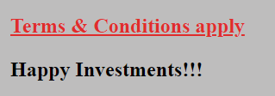
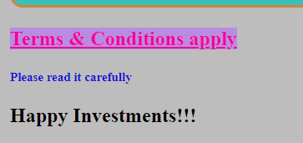
Sample output
When Hover

Slide 10
Attribute Selector implementation
Lets see the implementation of Attribute Selector.

Slide 11
Summary
We have seen what is Attribute selector and its implementation.
DO NOT WRITE ANYTHING
HERE. LEAVE THIS SPACE FOR
WEBCAM

Slide 12
Thank You
Proprietary content. ©Great Learning. All Rights Reserved. Unauthorized use or distribution prohibited

